Slide 1
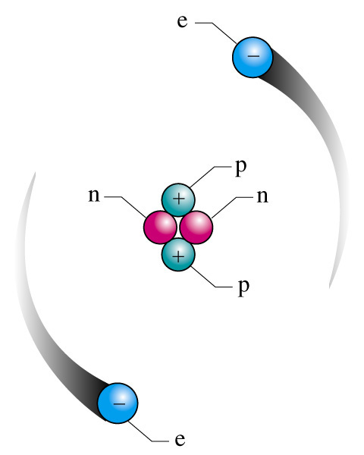
General Chemistry
Principles and Modern Applications
Petrucci • Harwood • Herring
8th Edition
Chapter 2: Atoms and the Atomic Theory
Philip Dutton
University of Windsor, Canada
Prentice-Hall © 2002
Slide <number> of 25
General Chemistry: Chapter 2
Prentice-Hall © 2002
Notes:
Chemistry 140 Fall 2002

Slide 2
Contents
Early chemical discoveries
Electrons and the Nuclear Atom
Chemical Elements
Atomic Masses
The Mole
Slide <number> of 25
General Chemistry: Chapter 2
Prentice-Hall © 2002

Slide 3
Early Discoveries
Lavoisier 1774 Law of conservation of mass
Proust 1799 Law of constant composition
Dalton 1803-1888 Atomic Theory
Slide <number> of 25
General Chemistry: Chapter 2
Prentice-Hall © 2002

Slide 4
Dalton’s Atomic Theory
Each element is composed of small particles called atoms.
Atoms are neither created nor destroyed in chemical reactions.
All atoms of a given element are identical
Compounds are formed when atoms of more than one element combine
Slide <number> of 25
General Chemistry: Chapter 2
Prentice-Hall © 2002

Slide 5
Dalton’s Atomic Theory
Dalton’s theory explains the law of conservation of mass.
Dalton’s theory also explain the law of constant composition. If all atoms of an element are alike in mass and if atoms unite in fixed numerical rations, the percent composition of a compound must have a uniqe value, regardless of the origin of the sample analyzed.
Dalton’s atomic theory led to a prediction-the law of multiple proportions. If two elements form more than a single compound, the masses of one element combined with a fixed mass of the second are in the ratio of small whole numbers.
Slide <number> of 25
General Chemistry: Chapter 2
Prentice-Hall © 2002

Slide 6
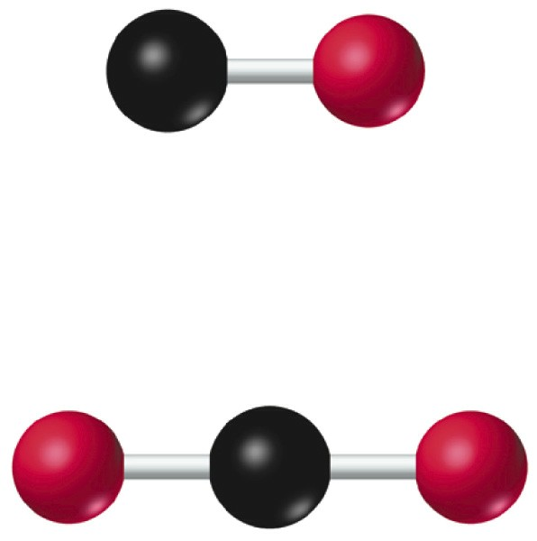
Consequences of Dalton’s theory
Law of Definite Proportions: combinations of elements are in ratios of small whole numbers.
In forming carbon monoxide, 1.33 g of oxygen combines with 1.0 g of carbon.
In the formation of hydrogen peroxide 2.66 g of oxygen combines with 1.0 g of hydrogen.
Slide <number> of 25
General Chemistry: Chapter 2
Prentice-Hall © 2002

Slide 7
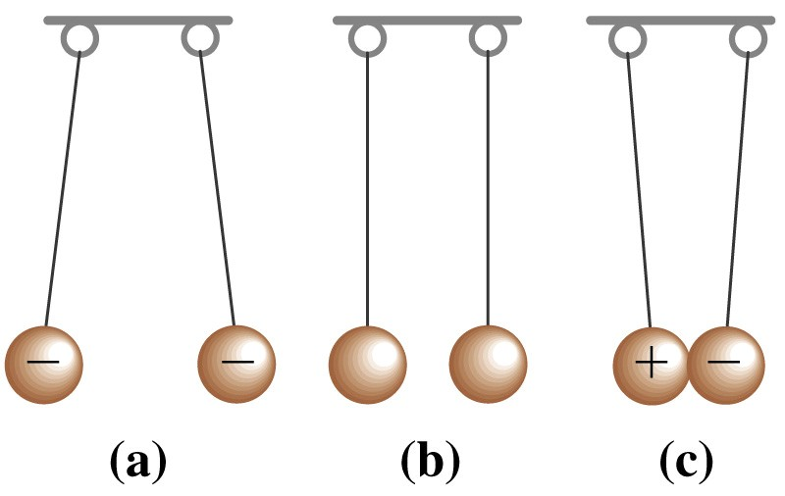
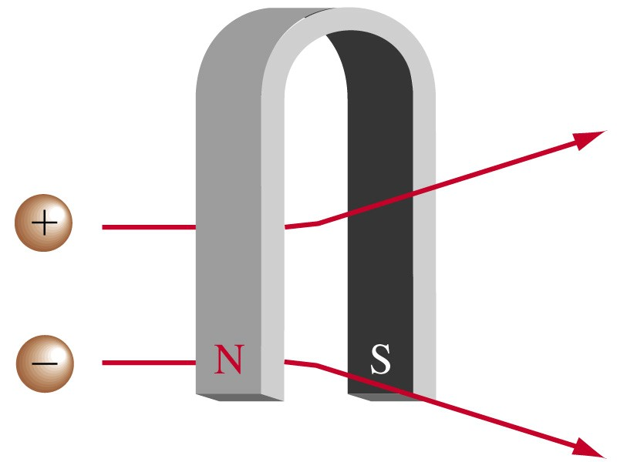
Behavior of charges
Slide <number> of 25
General Chemistry: Chapter 2
Prentice-Hall © 2002

Slide 8
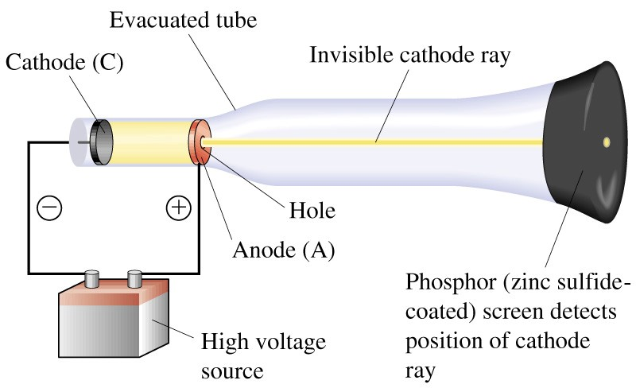
Cathode ray tube
The first cathode-ray tube was made by Michael Faraday (1791 1867) about 150 years ago. When he passed electricity through glass tubes from which most of the air had been evacuated, Faraday discovered cathode rays, a type of radiation emitted by the negative terminal, or cathode. The radiation crossed the evacuated tube to the positive terminal, or anode. Later scientists found that cathode rays travel in straight lines and have properties that are independent of the cathode material.
Slide <number> of 25
General Chemistry: Chapter 2
Prentice-Hall © 2002

Slide 9
The Discovery of Electrons
Another significant observation about cathode rays is that they are deflected by electric and magnetic fields in the manner expected for negatively charged particles.
Slide <number> of 25
General Chemistry: Chapter 2
Prentice-Hall © 2002

Slide 10

The Discovery of Electrons
J. J. Thomson (1856 1940) established the ratio of mass (m) to electric charge (e) for cathode rays, that is, Also, Thomson concluded that cathode rays are negatively charged fundamental particles of matter found in all atoms. (The properties of cathode rays are independent of the composition of the cathode.)
Cathode rays subsequently became known as electrons, a term first proposed by George Stoney in 1874.
Slide <number> of 25
General Chemistry: Chapter 2
Prentice-Hall © 2002

Slide 11
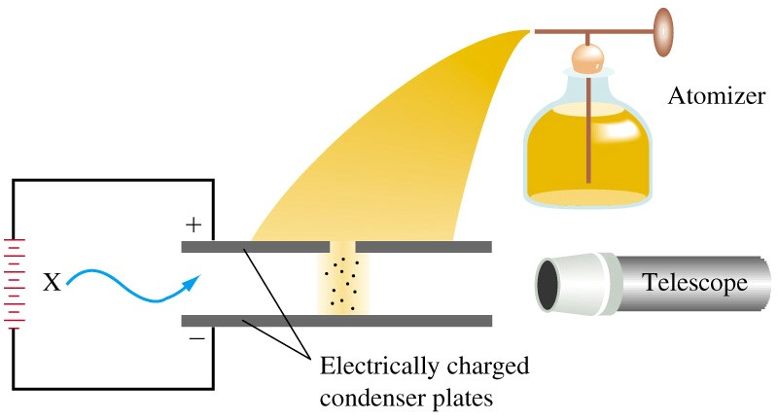
Charge on the electron
Robert Millikan (1868 1953) determined the electronic charge e through a series of oil-drop experiments (1906 1914). The currently accepted value of the electronic charge e, expressed in coulombs to five significant figures, is -1.6022 x 10 ⁻¹⁹ C. By combining this value with an accurate value of the mass-to-charge ratio for an electron, we find that the mass of an electron is 9.1094 x 10⁻²⁸ g
Slide <number> of 25
General Chemistry: Chapter 2
Prentice-Hall © 2002
Notes:
Chemistry 140 Fall 2002

Slide 12
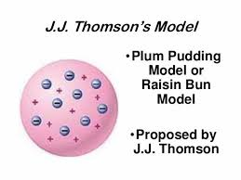
J.J Thomson’s Model
Once the electron was seen to be a fundamental particle of matter found in all atoms, atomic physicists began to speculate on how these particles were incorporated into atoms. The commonly accepted model was that proposed by J. J. Thomson. Thomson thought that the positive charge necessary to counterbalance the negative charges of electrons in a neutral atom was in the form of a nebulous cloud. Electrons, he suggested, floated in a diffuse cloud of positive charge.
Slide <number> of 25
General Chemistry: Chapter 2
Prentice-Hall © 2002

Slide 13
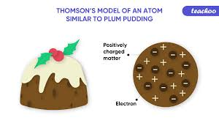
J.J Thomson’s Model
This model became known as the plum-pudding model because of its similarity to a popular English dessert.
According to this model, a helium atom would have a cloud of positive charge and two electrons.
Slide <number> of 25
General Chemistry: Chapter 2
Prentice-Hall © 2002

Slide 14
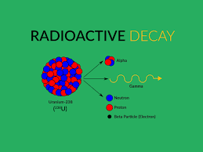

Radioactivity
In 1895, Wilhelm Roentgen (1845 1923) noticed that when cathode-ray tubes were operating, certain materials outside the tubes glowed or fluoresced. He showed that this fluorescence was caused by radiation emitted by the cathode-ray tubes. Because of the unknown nature of this radiation, Roentgen coined the term X-ray. We now recognize the X-ray as a form of high-energy electromagnetic radiation.
Slide <number> of 25
General Chemistry: Chapter 2
Prentice-Hall © 2002

Slide 15

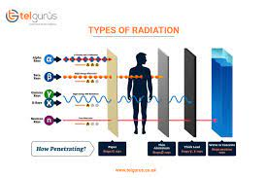
Ernest Rutherford (1871 1937) identified two types of radiation from radioactive materials, alpha and beta. Alpha particles carry two fundamental units of positive charge and have essentially the same mass as helium atoms. In fact, alpha particles are identical to ions..
Slide <number> of 25
General Chemistry: Chapter 2
Prentice-Hall © 2002

Slide 16
Beta particles are negatively charged particles produced by changes occurring within the nuclei of radioactive atoms and have the same properties as electrons. A third form of radiation, which is not affected by electric or magnetic fields, was discovered in 1900 by Paul Villard. This radiation, called gamma rays (γ), is not made up of particles; it is electromagnetic radiation of extremely high penetrating power.
Slide <number> of 25
General Chemistry: Chapter 2
Prentice-Hall © 2002

Slide 17
Radioactivity
Radioactivity is the spontaneous emission of radiation from a substance.
  X-rays and γ-rays are high-energy light.
  α-particles are a stream of helium nuclei, He²⁺.
  β-particles are a stream of high speed electrons that originate in the nucleus.
Slide <number> of 25
General Chemistry: Chapter 2
Prentice-Hall © 2002

Slide 18
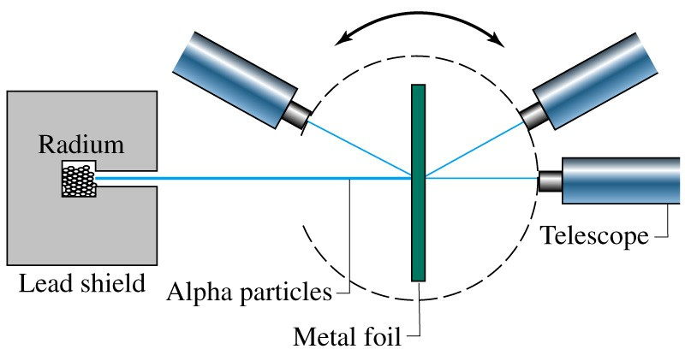
The nuclear atom
Geiger and Rutherford
1909
In 1909, Rutherford, with his assistant Hans Geiger, began a line of research using particles as probes to study the inner structure of atoms.
The majority of particles penetrated the foil undeflected.
Some particles experienced slight deflections.
Afew (about 1 in every 20,000) suffered rather serious deflections as they
penetrated the foil.
Asimilar number did not pass through the foil at all, but bounced back in
the direction from which they had come.
Slide <number> of 25
General Chemistry: Chapter 2
Prentice-Hall © 2002

Slide 19
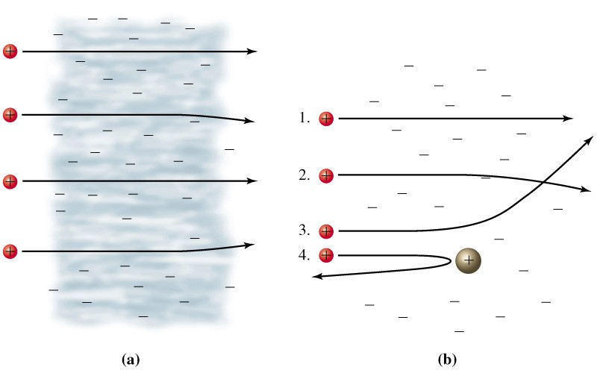
The α-particle experiment
Most of the mass and all of the positive charge is concentrated in a small region called the nucleus .
There are as many electrons outside the nucleus as there are units of positive charge on the nucleus
Slide <number> of 25
General Chemistry: Chapter 2
Prentice-Hall © 2002

Slide 20
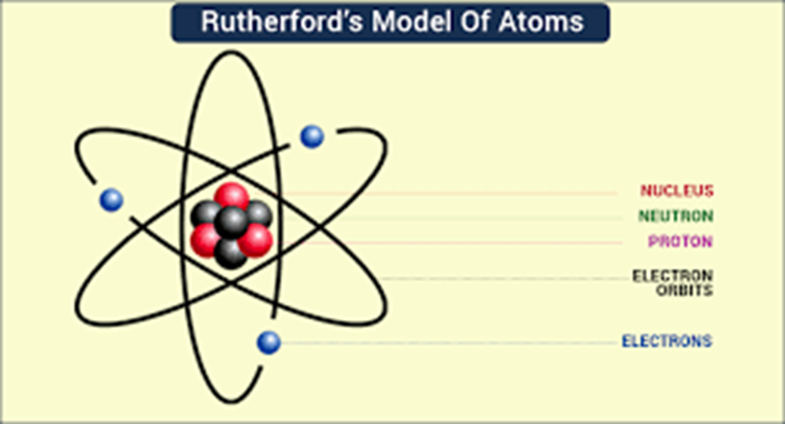
The nuclear atom
1. Most of the mass and all of the positive charge of an atom are centered in a very small region called the nucleus. The remainder of the atom is mostly empty space.
Slide <number> of 25
General Chemistry: Chapter 2
Prentice-Hall © 2002

Slide 21
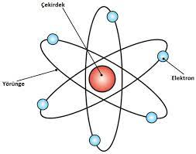
The nuclear atom
2. The magnitude of the positive charge is different for different atoms and is approximately one-half the atomic weight of the element.
Slide <number> of 25
General Chemistry: Chapter 2
Prentice-Hall © 2002

Slide 22
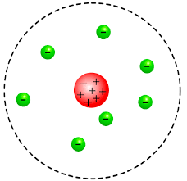
The nuclear atom
3. There are as many electrons outside the nucleus as there are units of positive charge on the nucleus. The atom as a whole is electrically neutral.
Slide <number> of 25
General Chemistry: Chapter 2
Prentice-Hall © 2002

Slide 23

The nuclear atom
Rutherford’s nuclear atom suggested the existence of positively charged fundamental particles of matter in the nuclei of atoms. Rutherford himself discovered these particles, called protons.
In 1932, James Chadwick showed that a newly discovered penetrating radiation consisted of beams of neutral particles. These particles, called neutrons, originated from the nuclei of atoms.
Slide <number> of 25
General Chemistry: Chapter 2
Prentice-Hall © 2002

Slide 24
Nuclear Structure
Atomic Diameter 10⁻⁸ cm Nuclear diameter 10⁻¹³ cm
1 Å
Particle Mass Charge
kg amu Coulombs (e)
Electron 9.109 x 10⁻³¹ 0.000548 –1.602 x 10⁻¹⁹ –1
Proton 1.673 x 10⁻²⁷ 1.00073 +1.602 x 10⁻¹⁹ +1
Neutron 1.675 x 10⁻²⁷ 1.00087 0 0
Slide <number> of 25
General Chemistry: Chapter 2
Prentice-Hall © 2002

Slide 25
Scale of Atoms
The heaviest atom has a mass of only 4.8 x 10⁻²² g
and a diameter of only 5 x 10⁻¹⁰ m.
Useful units:
1 amu (atomic mass unit) = 1.66054 x 10⁻²⁴ kg
1 pm (picometer) = 1 x 10⁻¹² m
1 Å (Angstrom) = 1 x 10⁻¹⁰ m = 100 pm = 1 x 10⁻⁸ cm
Biggest atom is 240 amu and is 50 Å across.
Typical C-C bond length 154 pm (1.54 Å)
Molecular models are 1 Å /inch or about 0.4 Å /cm
Slide <number> of 25
General Chemistry: Chapter 2
Prentice-Hall © 2002

Slide 26
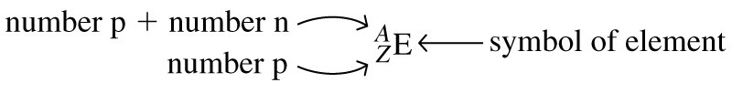
Properties of Protons, Neutrons, and Electrons
The number of protons in a given atom is called the atomic number, or the proton number, Z. The number of electrons in the atom is also equal to Z because the atom is electrically neutral. The total number of protons and neutrons in an atom is called the mass number, A. The number of neutrons, the neutron number, is A – Z.
An electron carries an atomic unit of negative charge, a proton carries an atomic unit of positive charge, and a neutron is electrically neutral.
Slide <number> of 25
General Chemistry: Chapter 2
Prentice-Hall © 2002

Slide 27
Isotopes, atomic numbers and mass numbers
To represent a particular atom we use the symbolism:
A= mass number Z = atomic number
Slide <number> of 25
General Chemistry: Chapter 2
Prentice-Hall © 2002
Notes:
Chemistry 140 Fall 2002
Often do not specify Z when writing. For example ¹⁴C, C specifies Z = 12.
Special names for some isotopes. For example hydrogen, deuterium, tritium.

Slide 28
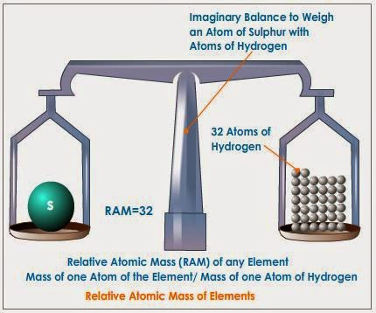
Measuring atomic masses
We cannot determine the mass of an individual atom just by adding up the masses of its fundamental particles. When protons and neutrons combine to form a nucleus, a very small portion of their original mass is converted to energy and released. However, we cannot predict exactly how much this socalled nuclear binding energy will be. Determining the masses of individual atoms, then, is something that must be done by experiment.
Slide <number> of 25
General Chemistry: Chapter 2
Prentice-Hall © 2002

Slide 29
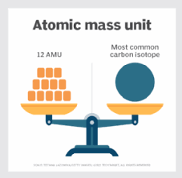
Measuring atomic masses
By international agreement, one type of atom has been chosen and assigned a specific mass. This standard is an atom of the isotope carbon-12, which is assigned a mass of exactly 12 atomic mass units, that is, 12 u. Next, the masses of other atoms relative to carbon-12 are determined with a mass spectrometer.
Slide <number> of 25
General Chemistry: Chapter 2
Prentice-Hall © 2002

Slide 30
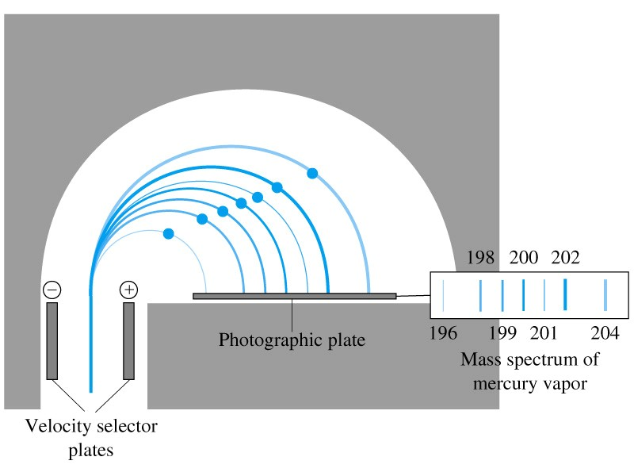
Measuring atomic masses
In this device, a beam of gaseous ions passing through electric and magnetic fields separates into components of differing masses. The separated ions are focused on a measuring instrument, which records their presence and amounts.
Slide <number> of 25
General Chemistry: Chapter 2
Prentice-Hall © 2002

Slide 31
Atomic mass
In a table of atomic masses, the value listed for carbon is 12.0107, yet the atomic mass standard is exactly 12. Why the difference?
Slide <number> of 25
General Chemistry: Chapter 2
Prentice-Hall © 2002

Slide 32
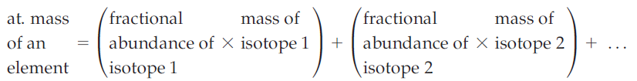
Atomic mass
The atomic mass standard is based on a sample of carbon containing only atoms of carbon-12, whereas naturally occurring carbon contains some carbon-13 atoms as well.
The existence of these two isotopes causes the observed atomic mass to be greater than 12. The atomic mass (weight)* of an element is the average of the isotopic masses, weighted according to the naturally occurring abundances of the isotopes of the element.
Slide <number> of 25
General Chemistry: Chapter 2
Prentice-Hall © 2002

Slide 33
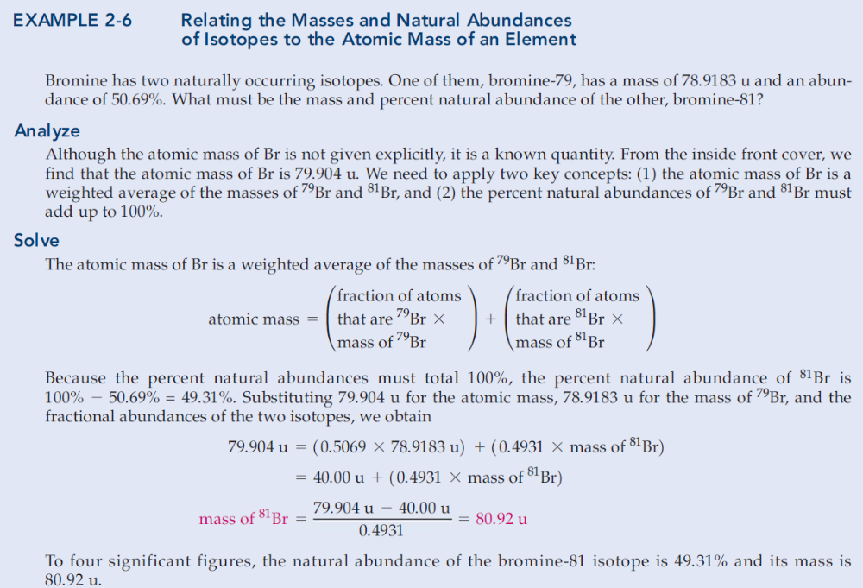
Slide <number> of 25
General Chemistry: Chapter 2
Prentice-Hall © 2002

Slide 34
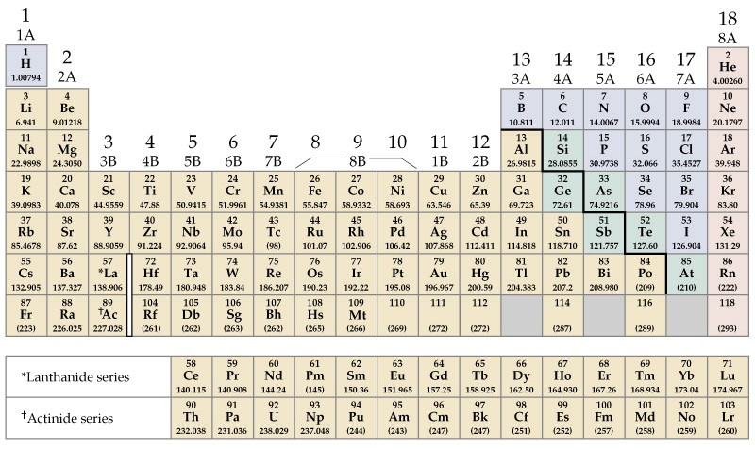
The Periodic table
Alkali Metals
Noble Gases
Alkaline Earths
Main Group
Halogens
Transition Metals
Main Group
Lanthanides and Actinides
Slide <number> of 25
General Chemistry: Chapter 2
Prentice-Hall © 2002

Slide 35
The Periodic Table
Read atomic masses.
Read the ions formed by main group elements.
Read the electron configuration.
Learn trends in physical and chemical properties.
We will discuss these in detail in Chapter 10.
Slide <number> of 25
General Chemistry: Chapter 2
Prentice-Hall © 2002

Slide 36
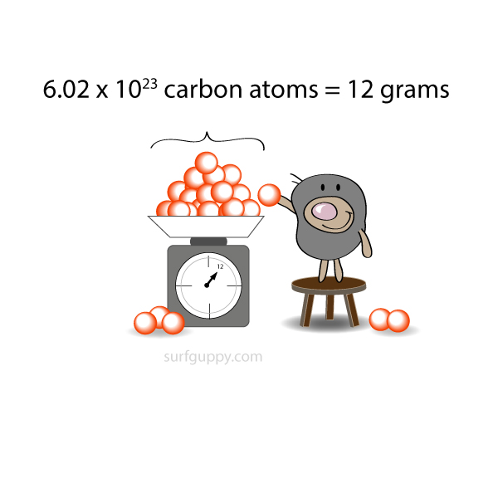
The Mole
Physically counting atoms is impossible. Starting with Dalton, chemists have recognized the importance of relative numbers of atoms, as in the statement that two hydrogen atoms and one oxygen atom combine to form one molecule of water. Yet it is physically impossible to count every atom in a macroscopic sample of matter. Instead, some other measurement must be employed, which requires a relationship between the measured quantity, usually mass, and some known, but uncountable, number of atoms.
Slide <number> of 25
General Chemistry: Chapter 2
Prentice-Hall © 2002

Slide 37
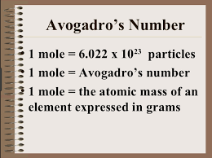
The Mole
The SI quantity that describes an amount of substance by relating it to a number of particles of that substance is called the mole (abbreviated mol).
Slide <number> of 25
General Chemistry: Chapter 2
Prentice-Hall © 2002

Slide 38
Avogadro’s number
The mole is an amount of substance that contains the same number of elementary entities as there are carbon-12 atoms in exactly 12 g of carbon-12.
N_{A} = 6.02214199 x 10²³ mol⁻¹
Slide <number> of 25
General Chemistry: Chapter 2
Prentice-Hall © 2002

Slide 39
Molar Mass
The molar mass, M, is the mass of one mole of a substance.
M (g/mol ¹²C) = A (g/atom ¹²C) x N_{A} (atoms ¹²C /mol ¹²C)
Slide <number> of 25
General Chemistry: Chapter 2
Prentice-Hall © 2002

Slide 40
Example 2-9
Combining Several Factors in a Calculation—Molar Mass, the Avogadro Constant, Percent Abundance.
Potassium-40 is one of the few naturally occurring radioactive isotopes of elements of low atomic number. Its percent natural abundance among K isotopes is 0.012%. How many ⁴⁰K atoms do you ingest by drinking one cup of whole milk containing 371 mg of K?
Want atoms of ⁴⁰K, need atoms of K,
Want atoms of K, need moles of K,
Want moles of K, need mass and M(K).
Slide <number> of 25
General Chemistry: Chapter 2
Prentice-Hall © 2002

Slide 41
Convert strategy to plan
and plan into action
Convert mass of K(mg K) into moles of K (mol K)
m_{K}(mg) x (1g/1000mg) ➔ m_{K} (g) x 1/M_{K} (mol/g) ➔ n_{K}(mol)
n_{K} = (371 mg K) x (10⁻³ g/mg)
x (1 mol K) / (39.10 g K)
= 9.49 x 10⁻³ mol K
Convert moles of K into atoms of ⁴⁰K
n_{K}(mol) x N_{A} ➔ atoms K x 0.012% ➔ atoms ⁴⁰K
atoms ⁴⁰K = (9.49 x 10⁻³ mol K) x (6.022 x 10²³ atoms K/mol K)
x (1.2 x 10⁻⁴ ⁴⁰K/K)
= 6.9 x 10¹⁷ ⁴⁰K atoms
Slide <number> of 25
General Chemistry: Chapter 2
Prentice-Hall © 2002

Slide 42
Chapter 2 Questions
3, 4, 11, 22, 33, 51, 55, 63, 83.
Slide <number> of 25
General Chemistry: Chapter 2
Prentice-Hall © 2002

Slide 43
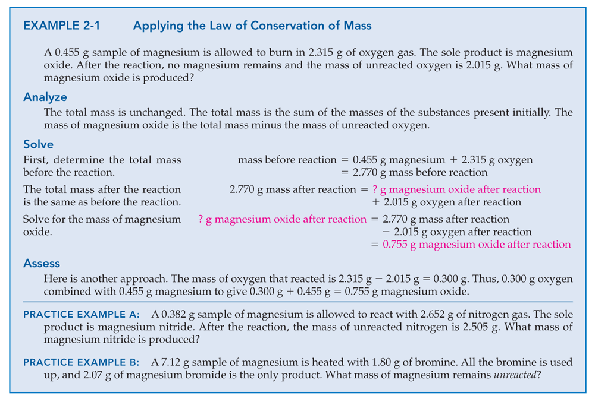
Copyright © 2011 Pearson Canada Inc.
2 - <number>

Slide 44
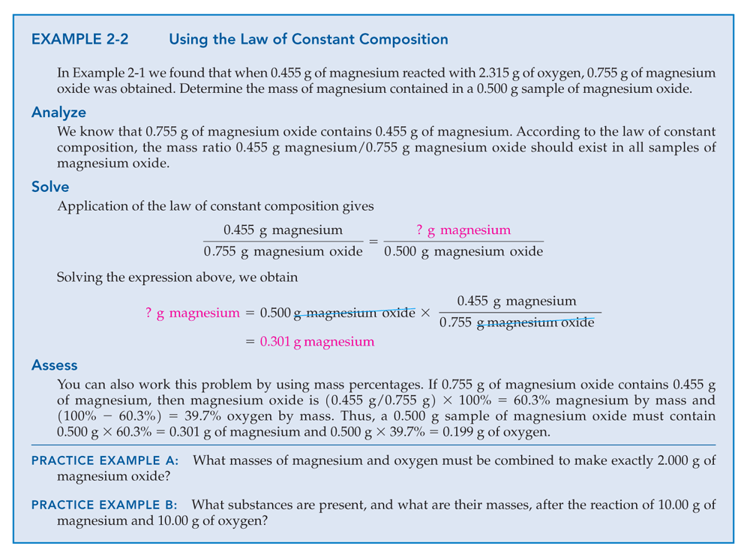
Copyright © 2011 Pearson Canada Inc.
2 - <number>

Slide 45
Chapter 2 Questions
There are three naturally occurring isotopes of magnesium. Their masses and percent natural abundances are 23.985042 u, 78.99%; 24.985837 u, 10.00%; and 25.982593 u, 11.01%. Calculate the weighted-average atomic mass of magnesium.
Slide <number> of 25
General Chemistry: Chapter 2
Prentice-Hall © 2002

Slide 46
Chapter 2 Questions
How many Cu atoms are present in a piece of sterlingsilver jewelry weighing 33.24 g? (Sterling silver is a silver copper alloy containing 92.5% Ag by mass.)
Slide <number> of 25
General Chemistry: Chapter 2
Prentice-Hall © 2002

Slide 47
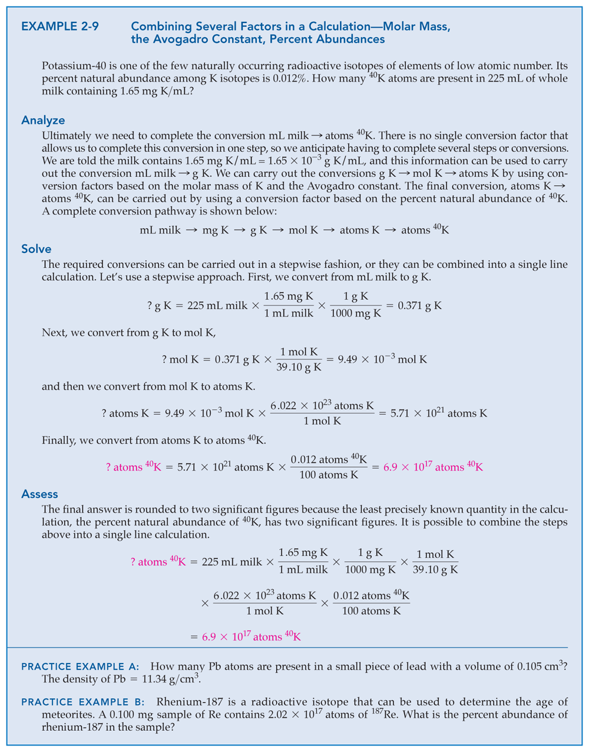
Copyright © 2011 Pearson Canada Inc.
2 - <number>

